Slide 1
Project Name: ATM Machine
Presented By
Supriya SN
Batch – 2021-61
Enroll no-EBEON0921441677

Slide 2
Contents
Introduction
Requirements
Problem Statement
Features
Advantages
Project Output
Conclusion

Slide 3
Introduction
ATM machine:
Automated teller machine enables the clients of a bank to have access to their account without going to the bank.
Performing few operations like
Withdraw
Deposit the amount
View the balance

Slide 4
Requirements
Core Java
JDK installed
Eclipse IDE

Slide 5
Problem Statement
This project is to make an automated teller machine with user’s account and password, bank account.
The system mainly used by the bank clients.

Slide 6
Features
My project is divided into two modules
* Checking Account
* Saving Account

Slide 7
Advantages
Quick and prompt service is possible .
It is beneficial for travelers.
Fast transactions.
Withdraw cash at any time

Slide 8
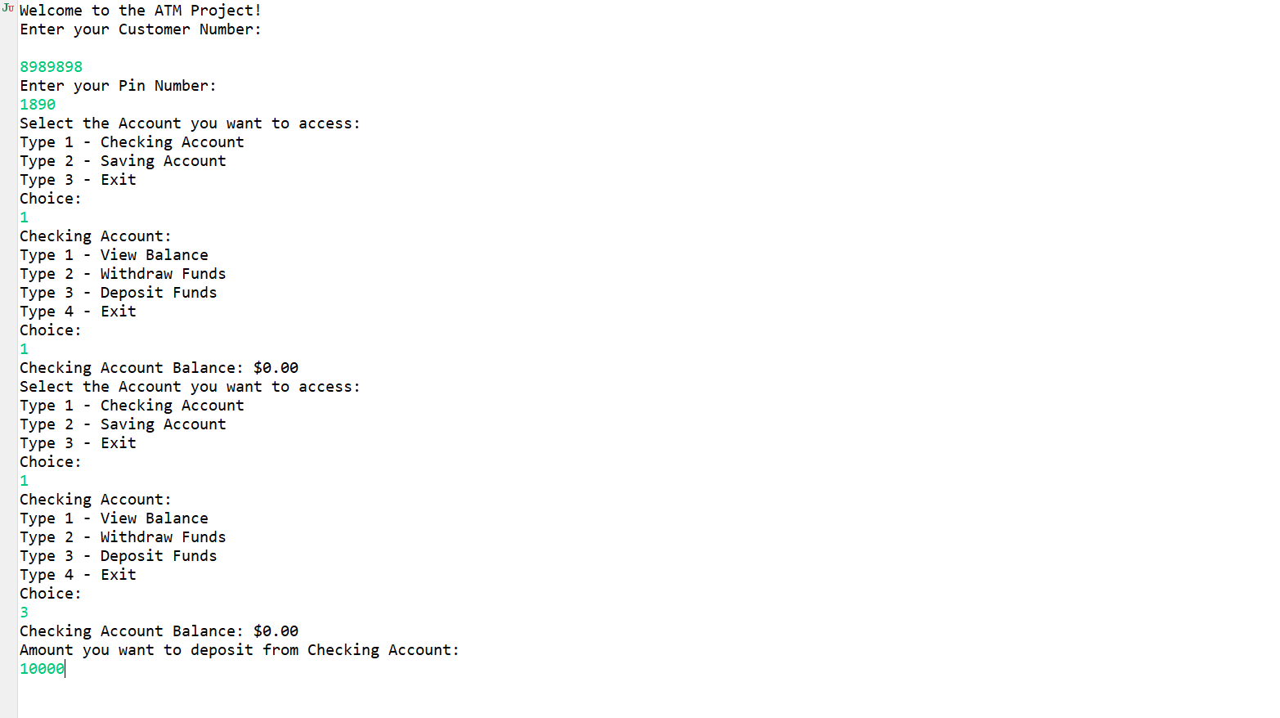
Output Checking Account

Slide 9
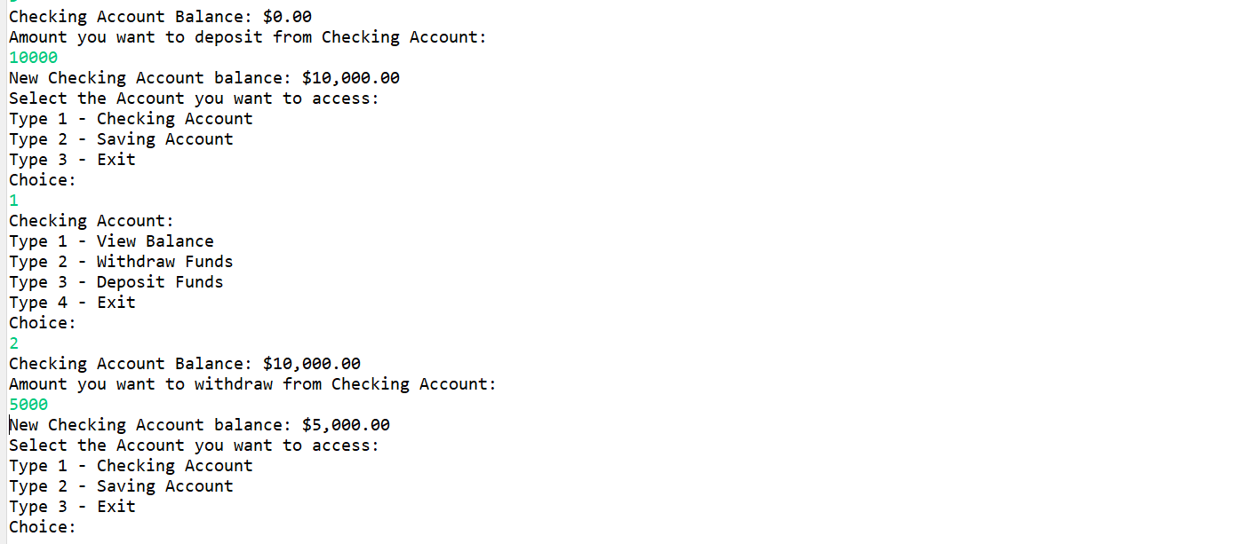

Slide 10
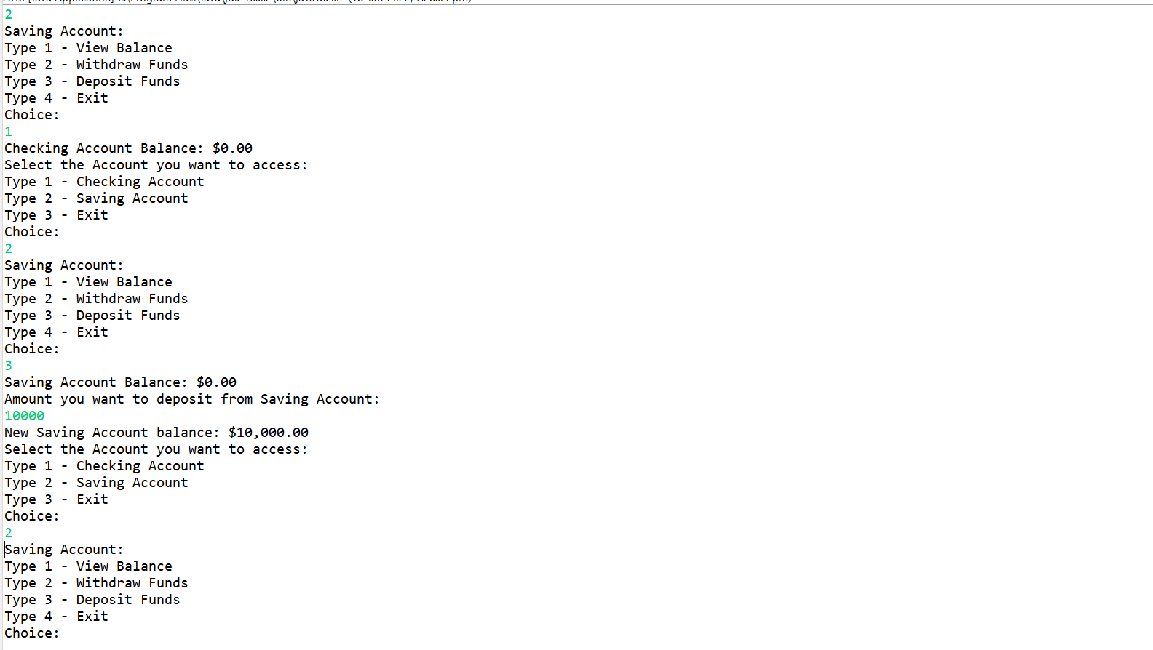
Saving Account

Slide 11
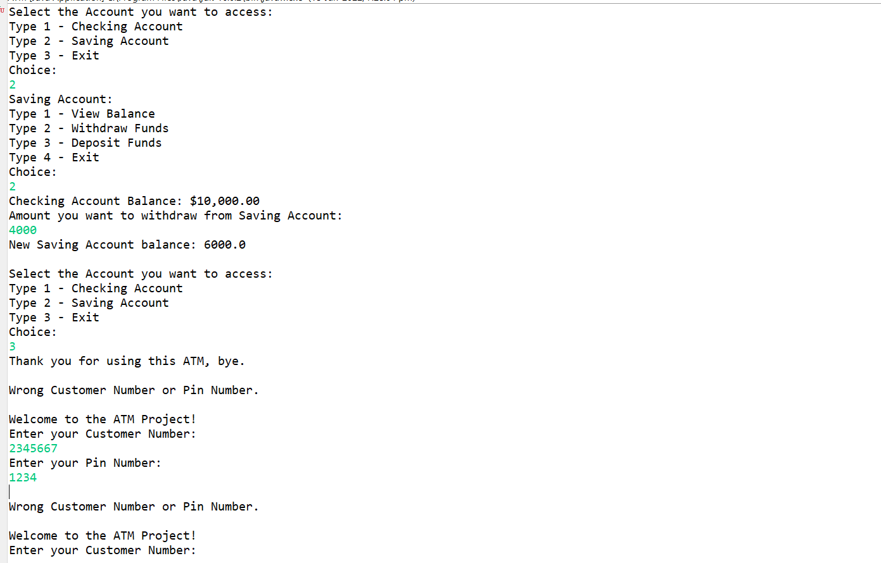

Slide 12
Conclusion
With the security of ATM improving it has now become a safe mode of transaction.
Hence it can be concluded that ATM is safe, fast, reliable, convenient, excisable, and any time money machine.

